Slide 1








Team members:
_________ _
_________ _
_________ _
_________ _
_________ _
Which padlock is more secure?

Slide 2
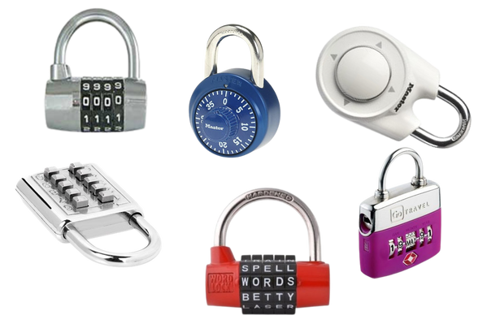
Objective of the problem
From the following collection of padlocks, which padlock is the most sure ?
What questions or issues do you propose to address based on the presentation?

Slide 3

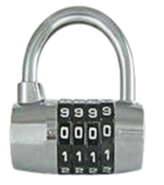
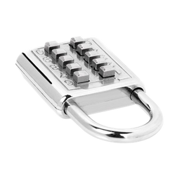
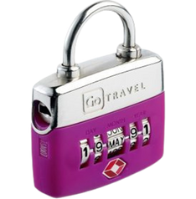
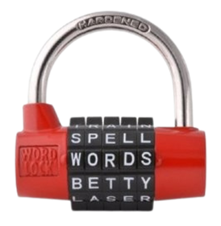
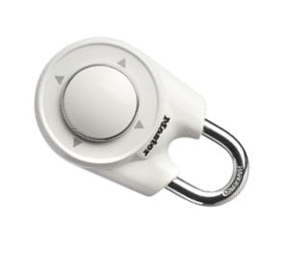
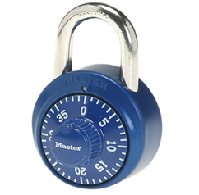
Information about padlocks
Padlock 1: Roulette numbering padlock
You can choose any 4-digit password.
The squares are rotating discs, with 10 numbers ranging from 0 to 9.
To open the padlock, the discs must be moved so that the password appears correctly located in each of the 4 boxes.
Padlock 2: Push-button padlock
You can choose a password of a maximum of 3 digits: 1, 2 or 3 digits.
The padlock does not detect the order in which we press the numbers.
To open it, you must slide the bottom tab.
Padlock 3: Padlock with dates
The password can be any date in the format DD – M – YY
Unreal dates are also allowed: 35 – JANUARY – 24
To open it, you must move the discs so that the date is visible, in the positions corresponding to DD, M or YY.
Padlock 4: Word padlock
You can choose any password with 5-letter words.
Only 10 letters are available on each disc.
The padlock has no way of checking whether the word entered makes sense or not. Therefore, the password may be a meaningless word.
There are repeated lyrics on the different albums.
To open it, the discs must be moved so that the password appears in the position next to the tab.
Padlock 5: Directional padlock
Any 4-direction password can be chosen (up, down, right, left)
A password can have repeated elements.
To enter a new password, you must press twice against the padlock.
When the code is correct, the padlock can be opened.
Padlock 6: Safe padlock
You can choose any password with 3 numbers, between 0 and 39.
Password does not support repeated digits.

Slide 4

Vocabulary about padlocks
vocabulary
Code:
Possible password that can be entered into the padlock.
Code elements:
Numbers, letters, symbols,... that make up a code.
Box:
Space (physical or not) in the padlock where the elements of the code are entered.
Elements of the box:
Numbers, letters, symbols,... that can be inserted into a box.
Key or password :
Correct code. When we enter it, the padlock opens.
Code:
1234, 2930, 1240, ... among other possibilities.
Code elements:
The code 1234 has 4 elements: 1, 2, 3 and 4.
Box:
It has 4 squares. Each space where we insert a number
Elements of the box:
Numbers between 0 and 9. Options we have in each box.
Key or password :
4921 (Because when we insert it, it opens)

Slide 5

How many codes does each padlock support?
Padlock number:
padlock information
What are the characteristics of the padlocks you are studying?
Simulation of possible codes
How to generate the list (even if it is partial) of possible codes that the padlock supports?
What is the total number of codes that your padlock supports?
If necessary, add your work on extra sheets.
Space for calculations/diagrams/ideas...

Slide 6
How many codes does each padlock support?
Space for calculations/diagrams/ideas...

Slide 7

How many codes does each padlock support?
Padlock number:
Number of codes:
Justification of how the number of codes was found
What counting strategies or techniques were used?
How did we make sure we didn't overcount or undercount codes?

Slide 8
How many codes does each padlock support?
If we had to open the padlock by trying all the codes, how long do you estimate it would take to open the padlock?
If we have the same padlock with one more box, how many total codes does it have?
What if we have one more element per box? What would happen then?

Slide 9

How many codes does each padlock support?
Fill in the table with the results of the rest of the locks, if you need to, ask the team in charge.
Padlock | Calculation of the number of codes | Result of the number of codes | time to open it

Slide 10
Which padlock is more secure?
Padlock 1: Roulette numbering padlock
Padlock 2: Push-button padlock
Padlock 3: Padlock with dates
Padlock 4: Word padlock
Padlock 5: Directional padlock
Padlock 6: Safe padlock
final answer
Develop a final, complete answer to the objective question.

Slide 11

Padlocks with new information
We've been given more information about the password...
Can we find the number of codes with the new information?
Padlock | New information | Result of the number of codes
 | Padlock 7: Roulette numbering padlock 1, from which we know that the password does not contain repeated digits.
Justification and calculations
 | Padlock 8: 2-button padlock, from what we know for sure the password has 7 digits .
Justification and calculations

Slide 12
Padlocks with new information
 | Padlock 9: Padlock 3 with dates, from what we know that neither the days nor the years contain repeated numbers .
Justification and calculations
 | Padlock 10: 5-way padlock, from what we know the password does not contain repeated directions .
Justification and calculations
 | Padlock 11: Safe padlock 6, from what we know the password has 2 repeated digits.
Justification and calculations

Slide 13

Padlock modeling
Let's compare the techniques used in each case...
What characterizes a padlock model?
r = number of boxes n = number of box elements
Padlock | Variables | Particular calculation | Written formula (explanation) | Algebraic formula ( r,n )
 | r = n =
 | r = n =
 | r = n =

Slide 14
Padlock modeling
Let's compare the techniques used in each case...
What characterizes a padlock model?
r = number of boxes n = number of box elements
Padlock | Variables | Particular calculation | Written formula (explanation) | Algebraic formula ( r,n )
 | r = n =
 | r = n =
 | r = n =

Slide 15





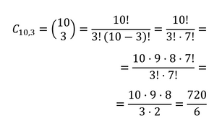



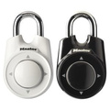
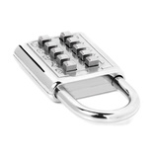
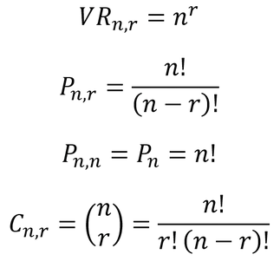








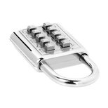

Roulette numbering padlock
There are 10 keys to choose from, of which only 3 must be chosen.
Combinations with the same numbers, but out of order, count as the same combination.
Combinations of 4 numbers can be chosen.
Each box has 10 elements.
A combination can have repeated elements.
Combinations of 3 numbers can be chosen.
Each box has 40 elements.
A combination cannot have repeated elements.
You can choose combinations of 4 elements ⬆️⬇️➡️⬅️
A combination cannot have repeated elements.
Push-button padlock
Safe padlock
Directional padlock (restrictions)
In how many different ways can we choose codes? with r boxes in elements in each box and if we can repeat elements ?
In how many different ways can we choose codes with r boxes and n elements in each box, if we cannot repeat elements ?
In how many different ways can we sort a given code of n elements?
In how many different ways can we choose combinations with r squares and n elements in each square, if the combinations cannot repeat elements and the order of the elements is indifferent ?
Answer the question...
Formula
Variation with repetition of n elements considered from r to r.
Variation without repetition of n elements considered from r to r.
(Particular case)
Combination of n elements considered from
r in r.
Model name
Permutation of n elements
Yes
No
CAN THEY BE REPEATED?
r boxes
n elements in each box
Yes
No
DOES IT INFLUENCE ORDER?

Slide 17

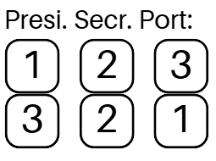
Combinatorics problems
Name and surnames: ___________________________________
Do these models work to solve more problems with contexts other than padlocks?
r = number of boxes n = number of box elements
How many different ways are there to…? | Code examples | Does the order matter? Can they be repeated? | r = ? n = ? | Procedure | Answer
Elect a president, secretary and spokesperson from a group of 12 people if one person cannot hold more than one position. |  | Does the order matter? Yes 123 (President 1) 321 ( President 3) Can they be repeated? No 111 | r = 3 (squares) n = 12 (elements)
Elect a president, secretary and spokesperson from a group of 12 people if one person can hold more than one position.
Form words of three different letters with the letters of the word PERMUTATION.
Paint a flag with 3 available colors in a horizontal arrangement and we must use a minimum of 2 and a maximum of 3 , and the colors cannot be repeated.
Choosing an ice cream if there are 6 different flavors and we are allowed to choose 2 different flavors.
With 4 cans of paint of different colors, how many mixtures of 2 different colors can we make?
Answer 4 questions from a list of 5.
Assign 2 twin brothers so that they do not coincide in the same class if the school has 4 3rd ESO classes.
Assemble a bead bracelet if we have 10 beads available, all of different colors.
Organize homework for 3 subjects in one afternoon.

Slide 18
Combinatorics problems
How many different ways are there to…? | Code examples | Does the order matter? Can they be repeated? | r = ? n = ? | Procedure | Answer
Combine 10 t-shirts for a week so as not to repeat a t-shirt any day of the week.
Combine the shirts from the previous case with 3 pairs of pants
Make vehicle registration plates that consist of 4 numbers and 3 letters of the alphabet, excluding vowels.
Select 6 different numbers from a total of 50.
Position 5 members of a basketball team if they have to line up to take a shot at the basket.
Make different groups of 5 people in a class of 25 students.
Form different 4-digit numbers with the digits 0,2,3,4,5,8 and 9.
Make different groups of workers if there are 20 people working in total and groups of 4 must be made.
Choose a 4-digit mobile phone PIN number.
Crossing football matches if there are 20 teams and everyone has to play against everyone else in the first and second leg.
5 friends can sit in a car if 2 of them have a license.
Choose 3 different sandwiches from a total of 6 types of sandwiches.

